Slide 1

Manahsrushti Organization Center for psychological development and research, Pune.
Project Aarsa
In association with Pune Police Department and Center for Police Research, Pune.

Slide 2
About Manahsrushti..
ManahSrushti organization was established in year 2015 by our founder and director Mr.Nikhil Walkikar.
For past 5 years, the organization has been working in various cities in Maharashtra to promote psychological development and to create a stress free and healthy society.
A large number of youth has been associated with the organization and with the help of these volunteers, the organization has been taking up various events, workshops, competitions to achieve its goals.

Slide 3
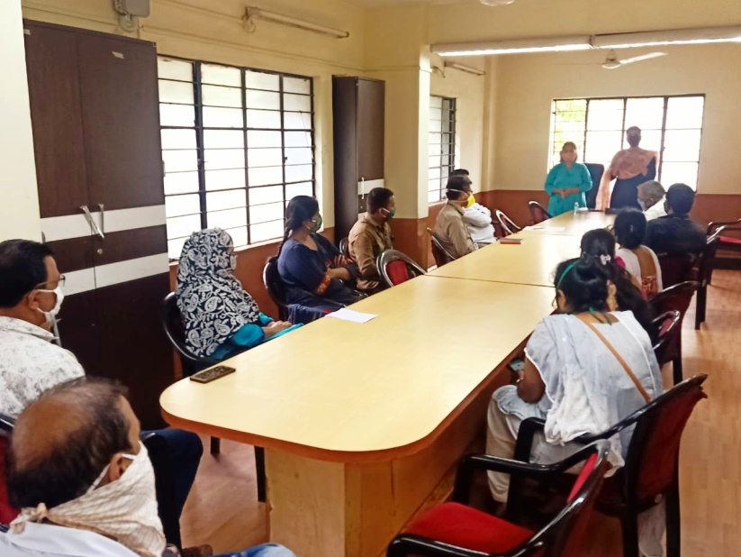
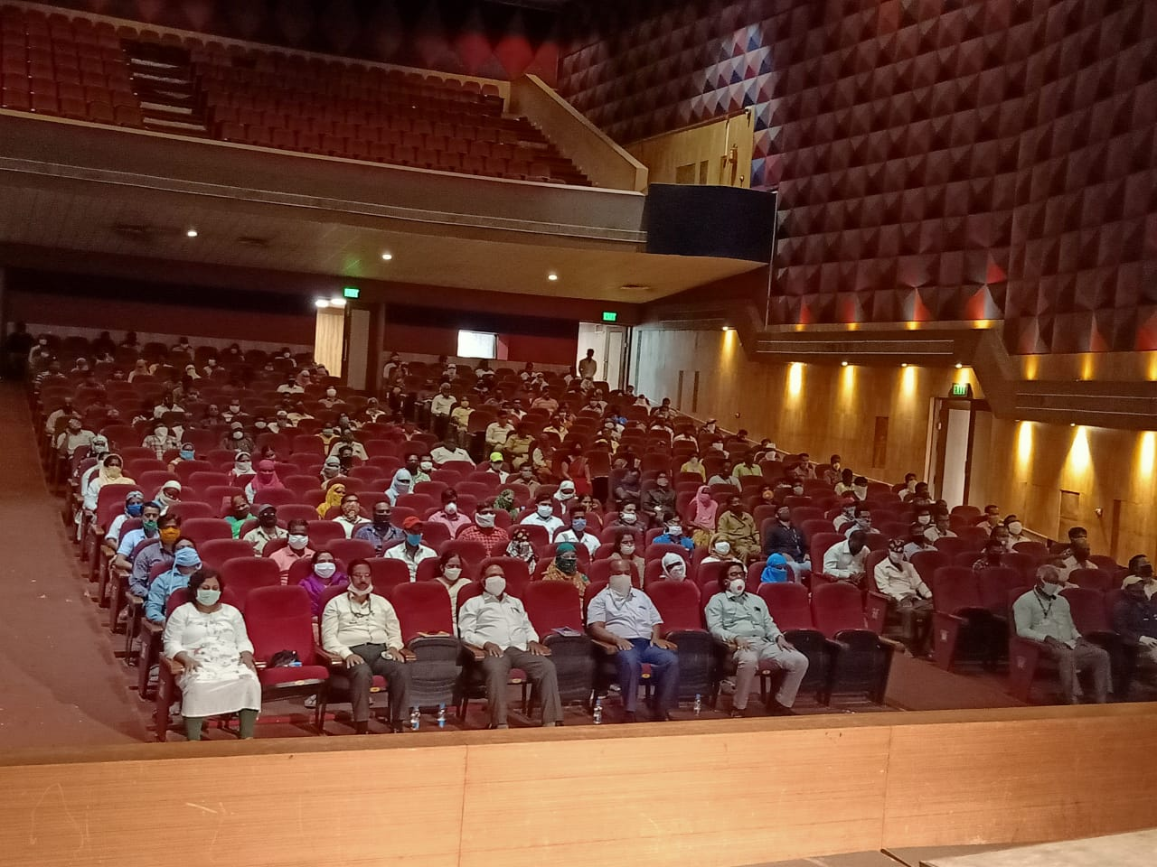
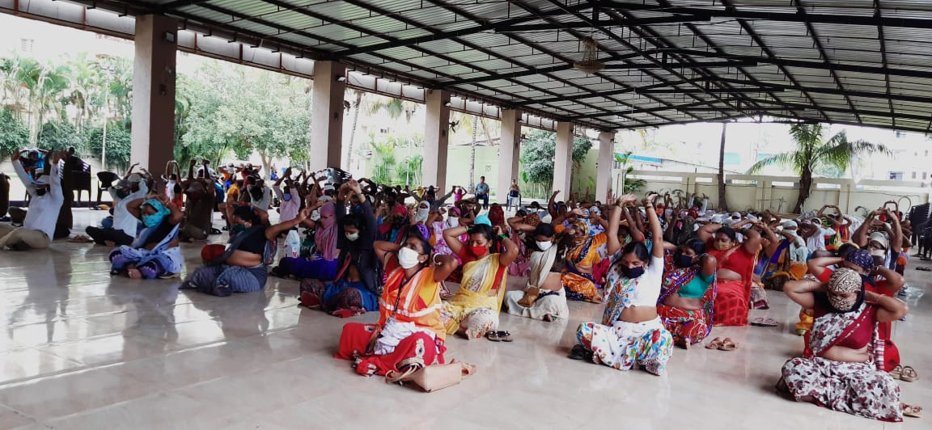
Recent project during COVID-19 Pandemic..
Healthy Body Joyful Mind..
A stress management workshop conducted for 8500 PMC employees

Slide 4
Project Aarsa (mirror)
Project Aarsa is a Psychological- research cum Survey project initiated by Manahsrushti organization to evaluate the effects of Lockdown on various economic, professional and age groups in the society.
Purpose:
To help Pune Police understand and analyze the effects of Lockdown on the different sectors of people and their changing mindsets.
To compare groups of different ages and economic backgrounds along with their professions.
To understand various coping styles and see how it affects depression, crime and addictive behavior.

Slide 5
Variables:
Coping: Coping is the ability to face and deal with problems, difficulties and adverse situations successfully.
Depression: Depression is a mental health disorder characterized by persistently depressed mood or loss of interest in activities
Suicidal Ideation: Suicidal Ideation is recurrent thinking, planning or attempting to take one’s own life.
Criminal Tendency: In this research, Criminal Tendency is measured by taking into consideration the major constructs of aggression, impulsivity, neuroticism and unlawful behaviour.
Addictive Behaviour: Addictive behaviour is an inability to control the cravings or urge to consume alcohol or drugs.

Slide 6
Data collection methods :
An online questionnaire was used for data collection during this project
Google forms were circulated through Whatsapp for collecting data from upper income groups.
In person interviewing-telephonic interviewing method were used for collecting data from daily wage workers like watchmen,milkmen,house-keepers etc.
Sneh foundation and Khelghar organization helped us to collect data from slum areas.
Ekalvya Organization helped us to collect data from Red Light Area in Pune.
Snowball sampling

Slide 7
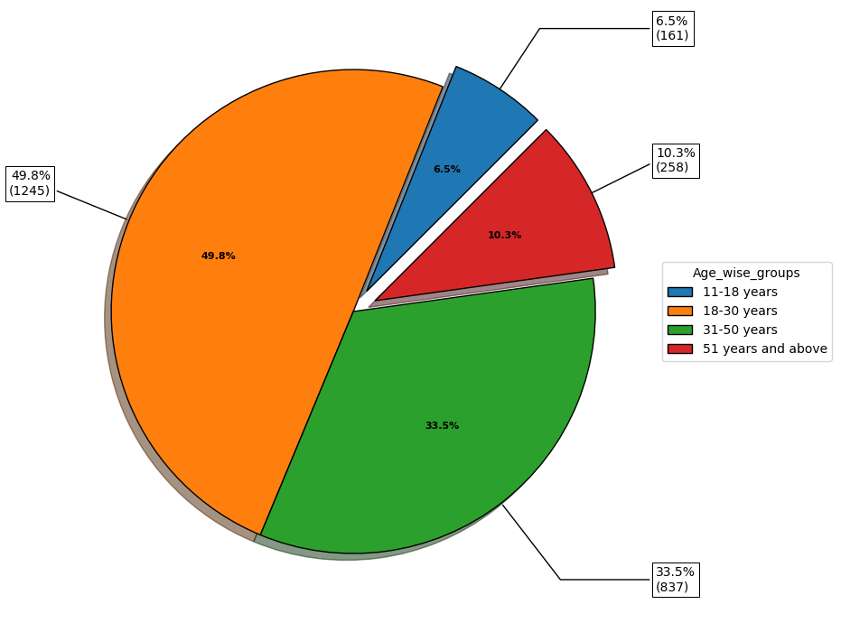
Collected data: Bifurcation as per Age group.

Slide 8
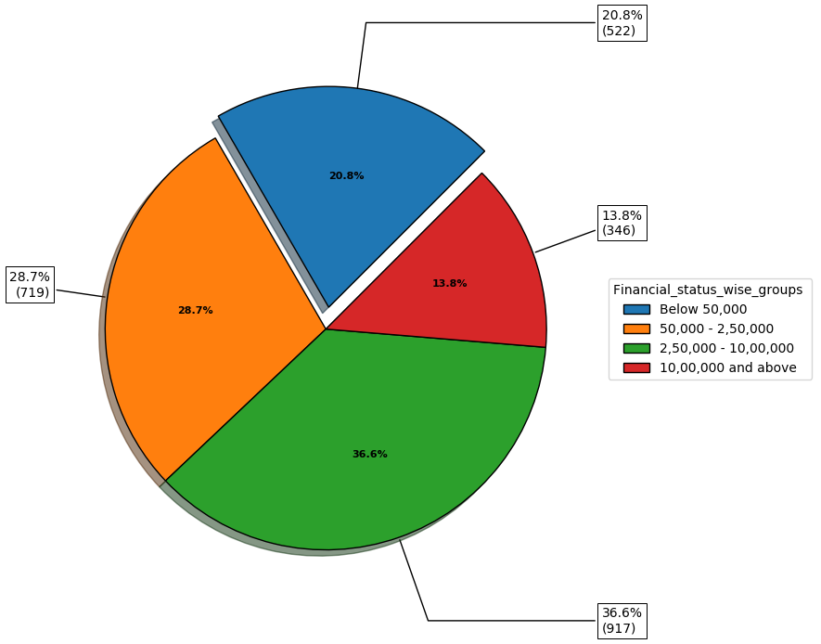
Collected data: Bifurcation as per Annual Income

Slide 9
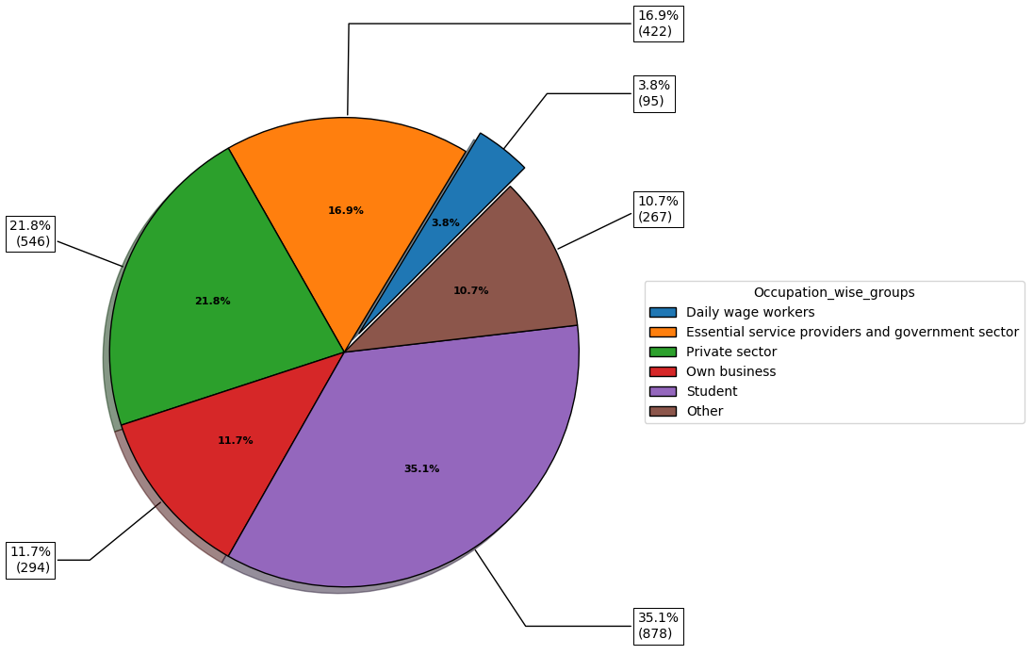
Collected data: Bifurcation as per Professions

Slide 10
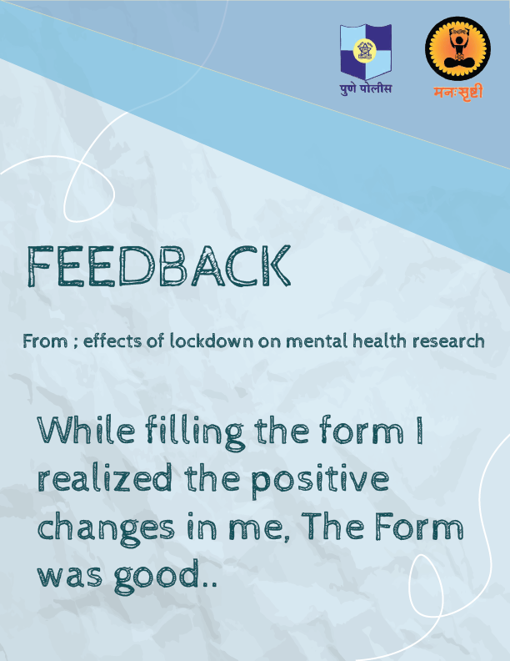
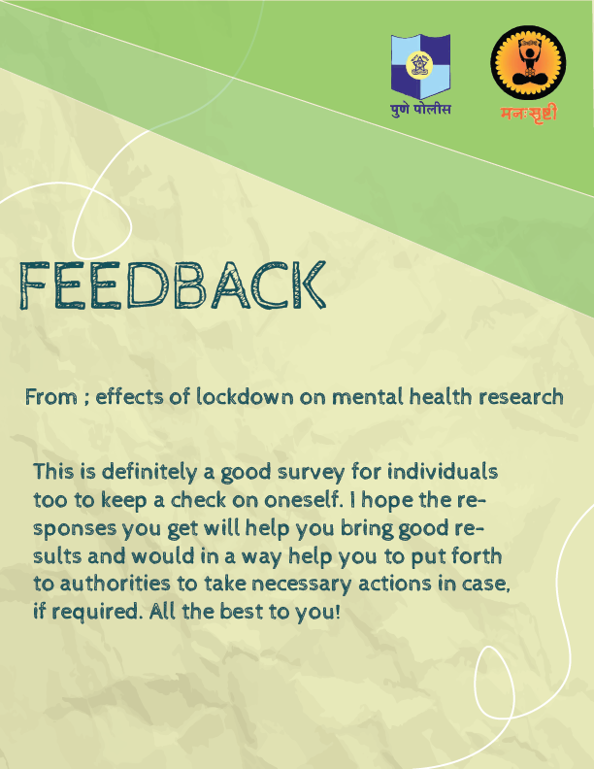
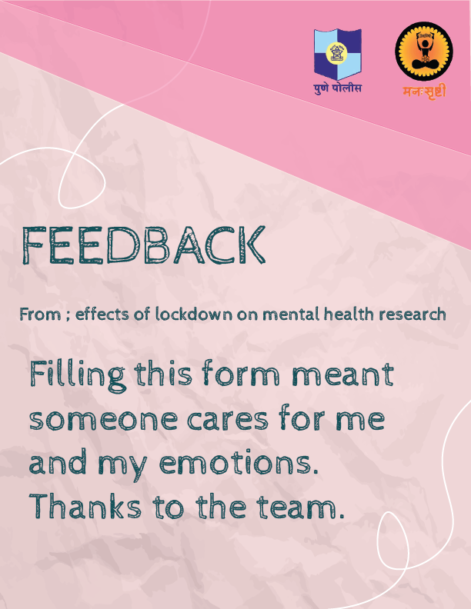
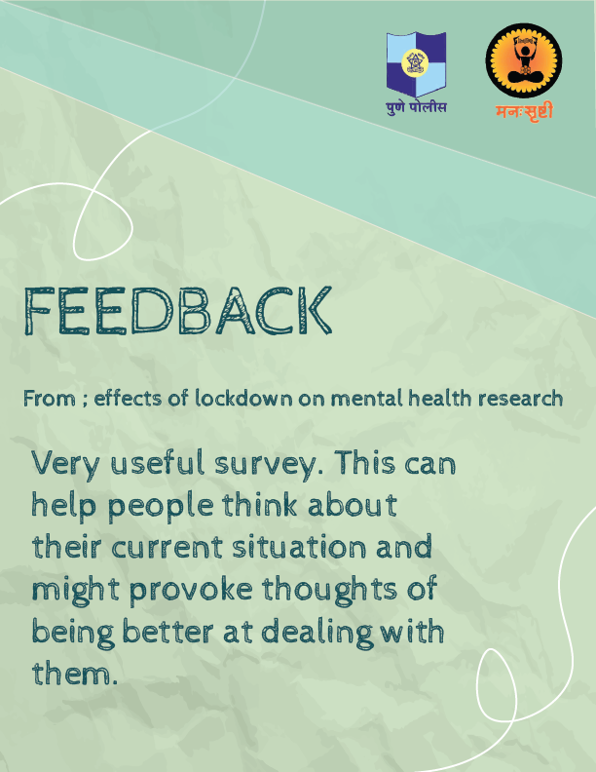
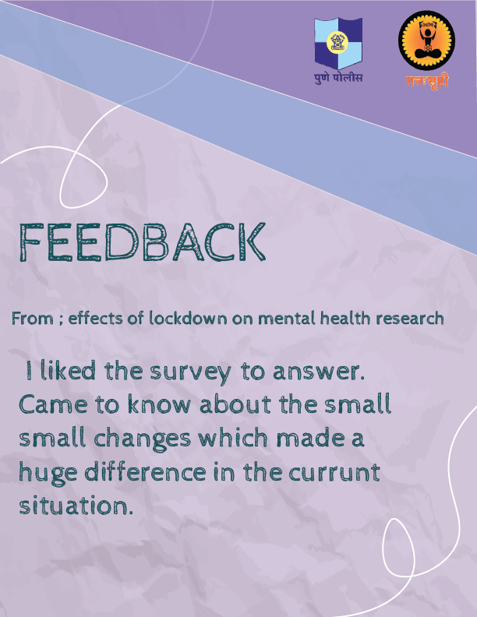
Feedbacks

Slide 11
Manah Srushti
NGO for Psychological
Development & Studies

